Slide 1
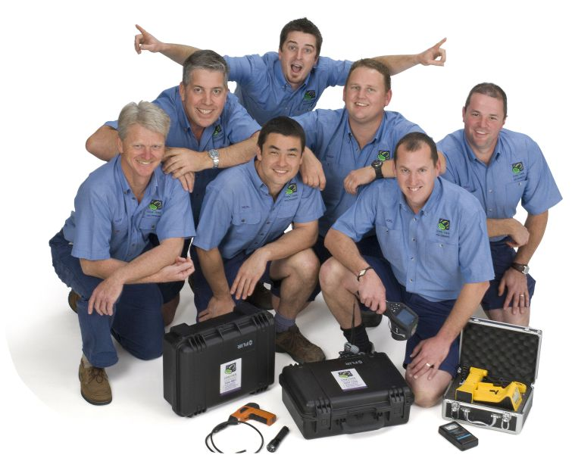
CONQUER TERMITES pest management

Slide 2
Who are we?
Rowan
HQ
Joel
Northside
Dan
HQ
Alex
HQ
Dave
HQ to GC
Nick
South Central
Andy
Northside
Alan
Northside
Kuy
HQ

Slide 3
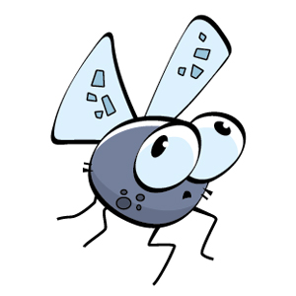
What do we do?
Termite inspections
Termite treatments
General pest treatments (cockroaches, ants, spiders, silverfish)
Rodents & other pests
Pre-construction treatments
Pre-purchase (timber pests) inspections
Pre-purchase & building inspections

Slide 4
Who do we serve?
Home owners
Builders
Handymen
Tenants
Sales agents
Property managers
Commercial businesses
Most often separate into proactive or reactive

Slide 5
Proactive approach - $
Full termite treatment
Full termite inspection annually
Peace of Mind & a Happy Home!
TimberSecure
Insurance

Slide 6
Reactive approach - $$$
Call with live termites
Inspection & initial treatment
Follow up check to see if colony eliminated
Possible further initial treatment
Full external termite treatment
Follow up check
Possible 3 or 6 monthly inspection required
Full termite inspection annually
Finally Peace of Mind!

Slide 7
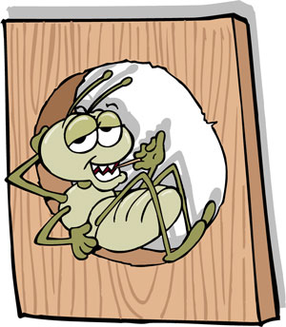
What can you do?
Regularly inspect your home for:
Moisture around the house
Loose timbers & stumps
Mud tubes (fences & perimeter)
Bubbled paint
Rippled timber
Alates (flying termites)
Mud packs through walls

Slide 8
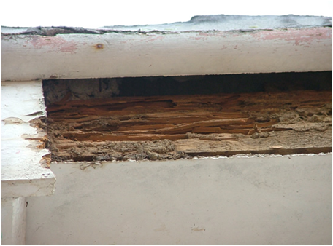
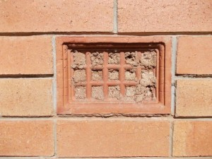
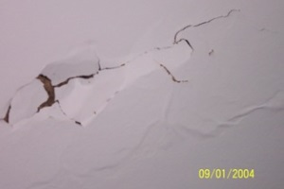
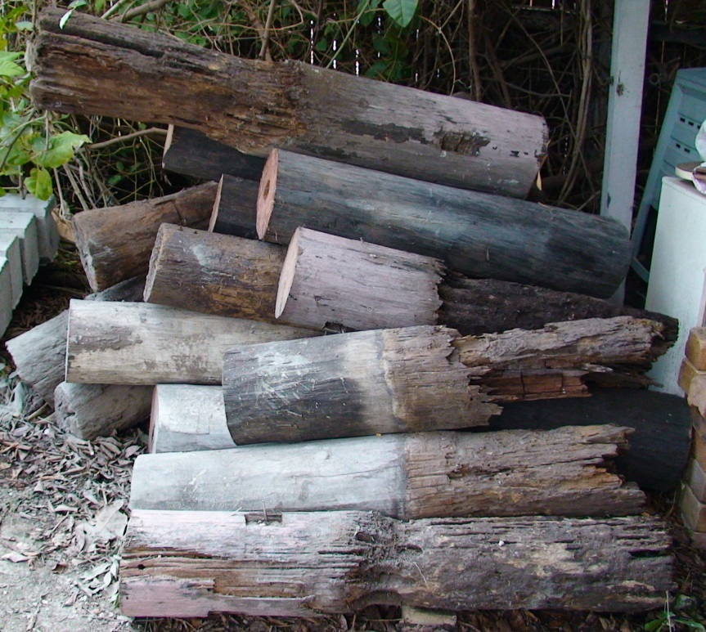
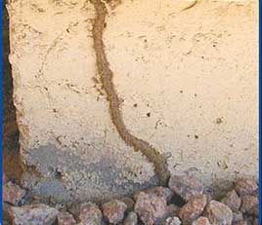
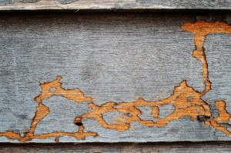
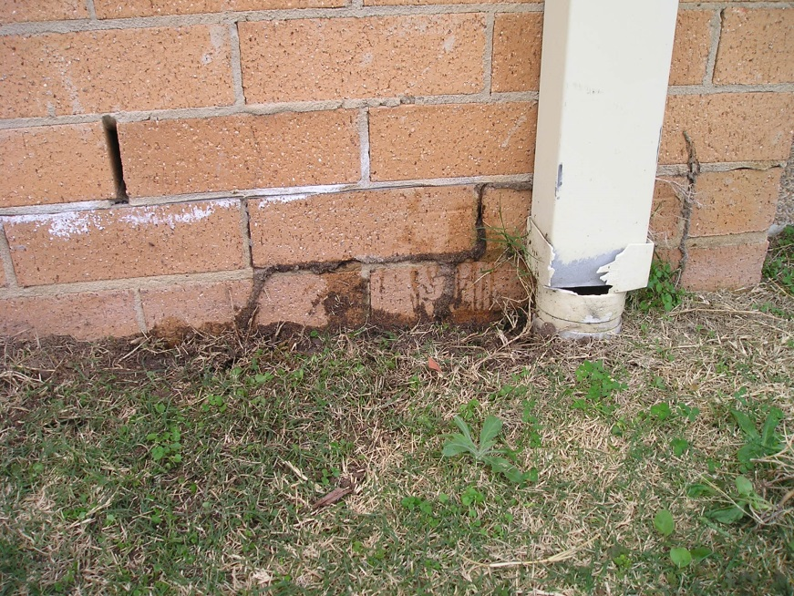
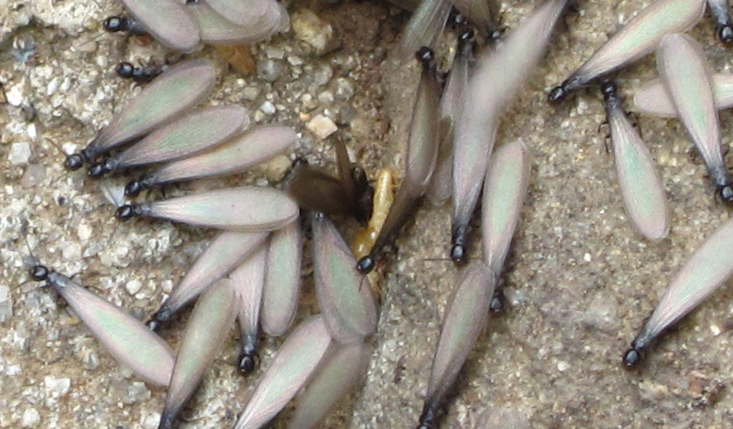

Slide 9
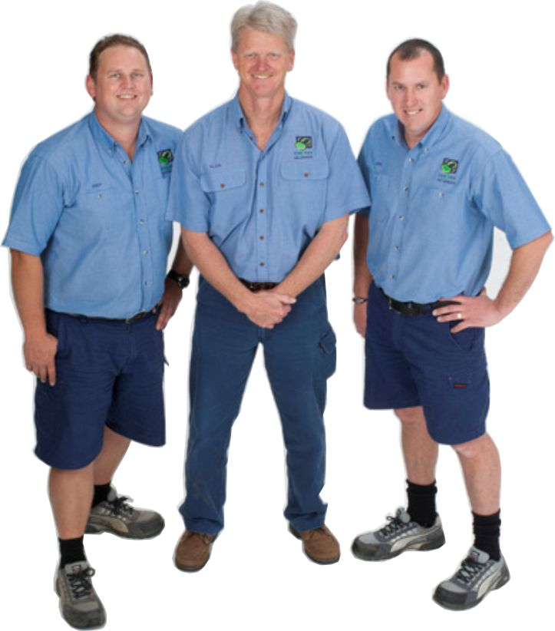
What do we bring?
Experience
Education & training
Knowledge of construction types
Fresh set of trained eyes
Technology & tools
(tapper, torch, moisture meter, borescope, thermal imaging camera & termatrac)

Slide 10
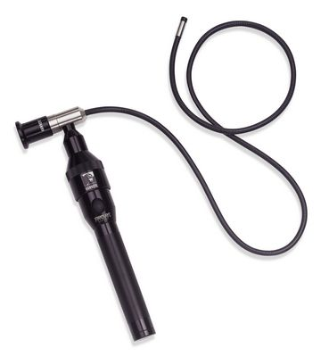
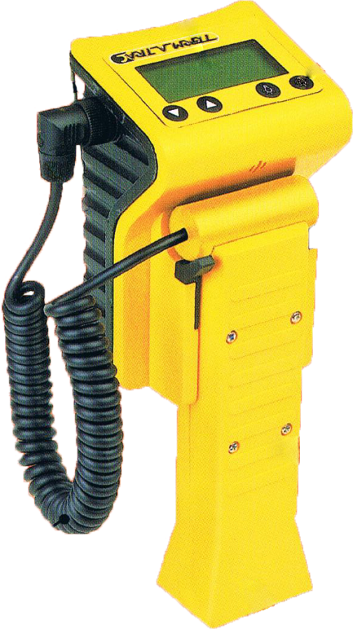
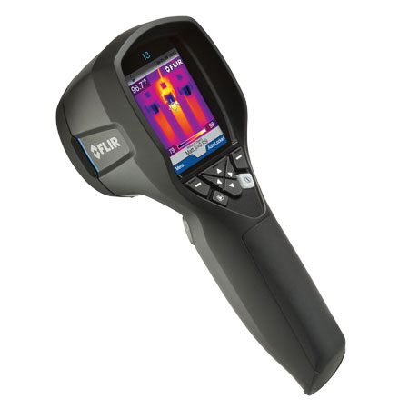
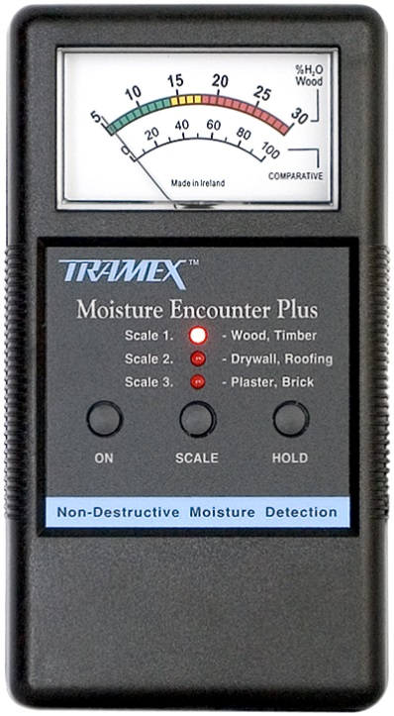
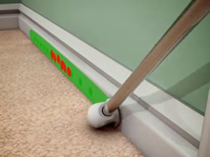
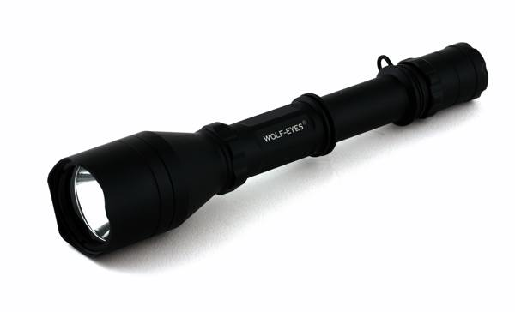

Slide 11
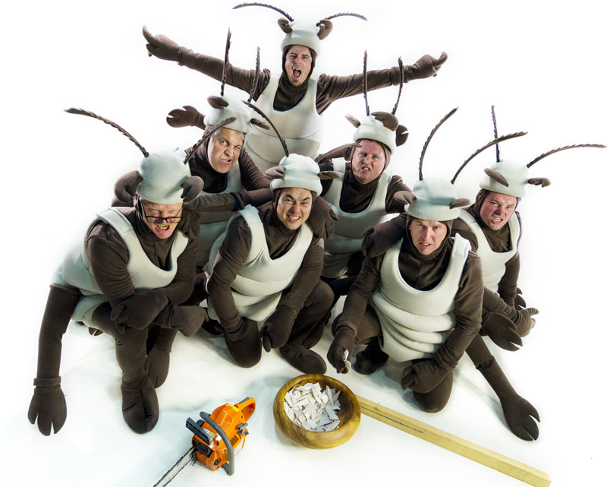
What makes us remarkable?
Fully licensed
Fully accredited
Fully insured
Well presented
Polite
Knowledgeable
Trustworthy
On time, every time…
And they’re really nice guys!

